Slide 1
Greedy Algorithms II

Slide 2
Announcements
Exam Corrections due today
HW 4 due Mon
Lab on Mon

Slide 3
Greedy Algorithms
Usually applied to optimization problems, but considered a general purpose technique.
Construct solution through sequence of steps where each step is:
Feasible: satisfies problem’s constraints.
Locally Optimal: has to be best local choice
Irrevocable: once made, choice can’t be changed at later step.

Slide 4
Shortest Path Problem
Single Source Shortest Path Problem: For a given vertex, the source, find the shortest paths to all other vertices.
Not the same as TSP.
Used in: transportation, networking, scheduling, speech recognition, document formatting, robotics, compilers, video games, etc.

Slide 5
Dijkstra’s Algrithm
Applicable to directed and undirected graphs with non-negative edge weights.
Every iteration, add the i^{th} nearest vertex to the set of paths.
b
4
c
3
2
5
6
a
7
d
4
e

Slide 6
Dijkstra’s Algrithm
Applicable to directed and undirected graphs with non-negative edge weights.
Every iteration, add the i^{th} nearest vertex to the set of paths.
b
4
c
3
2
5
6
a
7
d
4
e

Slide 7
Dijkstra’s Algrithm
Applicable to directed and undirected graphs with non-negative edge weights.
Every iteration, add the i^{th} nearest vertex to the set of paths.
b
4
c
3
2
5
6
a
7
d
4
e

Slide 8
Dijkstra’s Algrithm
Applicable to directed and undirected graphs with non-negative edge weights.
Every iteration, add the i^{th} nearest vertex to the set of paths.
b
4
c
3
2
5
6
a
7
d
4
e

Slide 9
Dijkstra’s Algrithm
Applicable to directed and undirected graphs with non-negative edge weights.
Every iteration, add the i^{th} nearest vertex to the set of paths.
b
4
c
3
2
5
6
a
7
d
4
e

Slide 10
Dijkstra’s Algorithm
To add the i^{th} nearest vertex each iteration, label each vertex with 2 values:
d: the length of the shortest path from source to this vertex discovered so far.
When node is added to tree of shortest paths, d will be length of absolute shortest path from source to vertex.
p: the parent vertex on shortest path discovered.
Each iteration, add vertex with smallest value for d.

Slide 11
Dijkstra’s Algrithm
(3,a)
(∞,--)
b
4
c
3
2
5
6
a
7
d
4
e
(7,a)
(∞,--)

Slide 12
Dijkstra’s Algrithm
(3,a)
(3+4,b)
b
4
c
3
2
5
6
a
7
d
4
e
(3+2,b)
(∞,--)

Slide 13
Dijkstra’s Algrithm
(3,a)
(3+4,b)
b
4
c
3
2
5
6
a
7
d
4
e
(5,b)
(5+4,d)

Slide 14
Dijkstra’s Algrithm
(3,a)
(7,b)
b
4
c
3
2
5
6
a
7
d
4
e
(5,b)
(5+4,d)

Slide 15
Dijkstra’s Algrithm
(3,a)
(7,b)
b
4
c
3
2
5
6
a
7
d
4
e
(5,b)
(9,d)
Can find shortest path by following chain back from destination vertex.

Slide 16
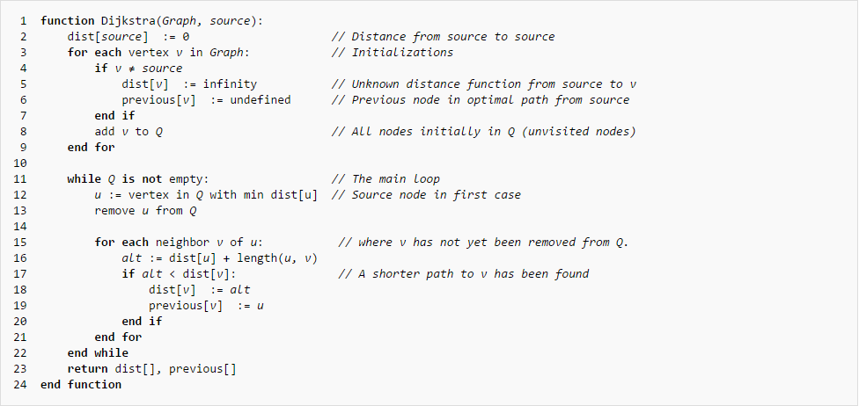
Dijkstra’s Algorithm

Slide 17
Huffman Trees and Codes

Slide 18
Encoding
We encode n-symbol alphabet using a sequence of bits called a codeword.
Fixed-Length Encoding: assign each symbol a bit-string of same length m, m ≥ log₂n. E.g. ASCII
Variable-Length Encoding: use shorter bit-strings for more frequent symbols, e.g. Morse Code.
Leads to problem of detecting begin and end of codewords.
Prefix-Free Code: no codeword is a prefix of another one.
Notes:
Morse code – e, a, 2 symbols, z, q, 4 symbols

Slide 19

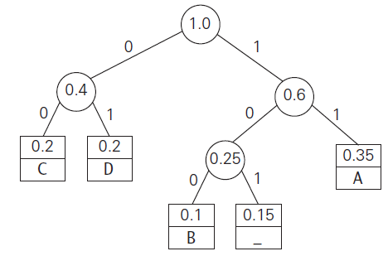
Huffman Encoding (Greedy)
Given an alphabet with associated symbol frequencies:
Build a tree, based on frequencies – 0 for left child, 1 for right child:

Slide 20

Huffman’s Algorithm
Initialize n one-node trees. Record the frequency of the symbol in the node as the tree’s weight.

Slide 21
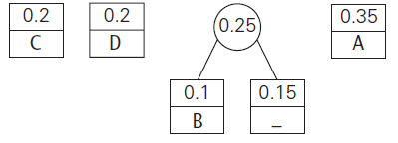
Huffman’s Algorithm
Repeat until a single tree is obtained:
Find the two trees with the smallest weight – ties can be broken arbitrarily or by heuristic.
Make the two trees left and right child of a new node and make the weight of the new subtree root the sum of the weights of the left and right child.
Continue the process to make a single tree.

Slide 22
Huffman Encoding
Given finished tree:
How would you encode DAD?

Slide 23
Huffman Encoding
Given finished tree:
How would you encode DAD? 011101
How would you decode 10011011011101?

Slide 24
Huffman Encoding
Given finished tree:
How would you encode DAD? 011101
How would you decode 10011011011101? BAD_AD

Slide 25

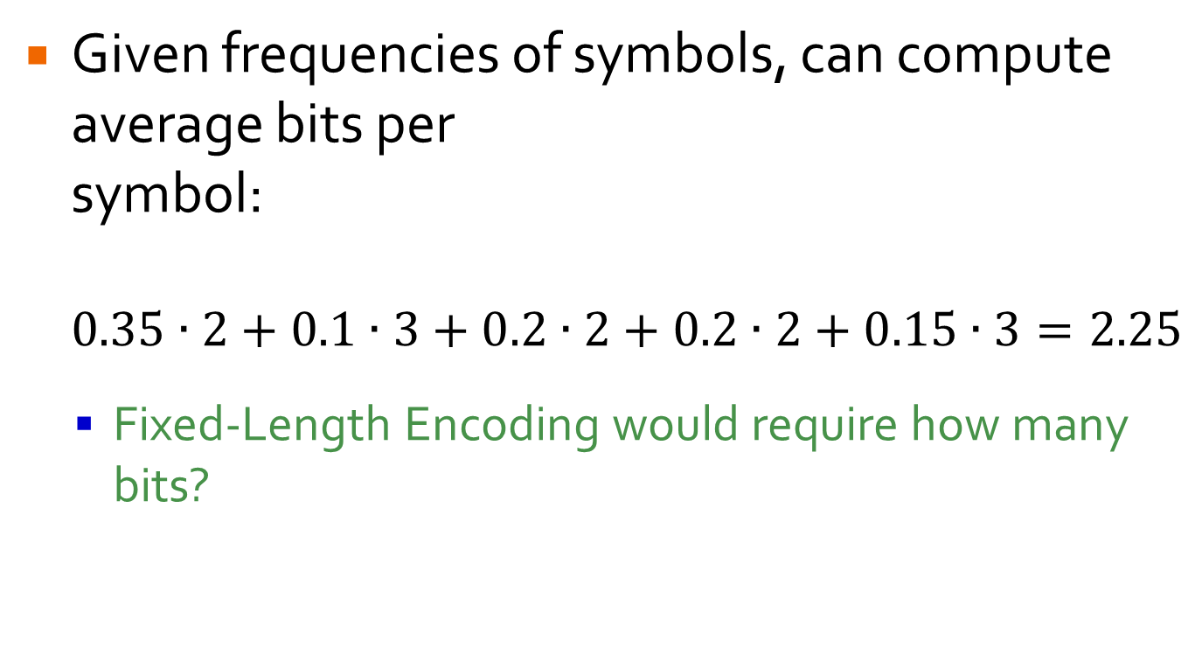
Compression Ratio
Given frequencies of symbols, can compute average bits per symbol: $0.35∙2+0.1∙3+0.2∙2+0.2∙2+0.15∙3=2.25$
Fixed-Length Encoding would require how many bits?

Slide 26
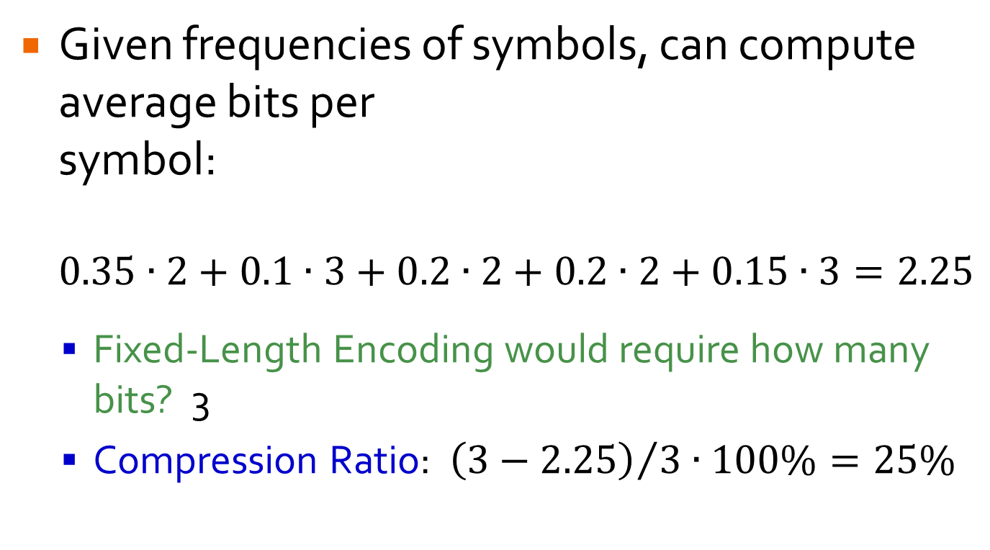
Compression Ratio
Given frequencies of symbols, can compute average bits per symbol: $0.35∙2+0.1∙3+0.2∙2+0.2∙2+0.15∙3=2.25$
Fixed-Length Encoding would require how many bits? 3
Compression Ratio: ${\left(3−2.25\right)}/{3∙100\%=25\%}$

Slide 27
Compression Ratio
Standard measure of compression algorithm’s effectiveness.
25% compression ratio means encoding of text will take 25% less memory than fixed length encoding.
Huffman encoding: 20-80% compression ratio depending on text characteristics.
More sophisticated variations exist: dynamic Huffman, Lempel-Ziv, etc.

